Slide 1
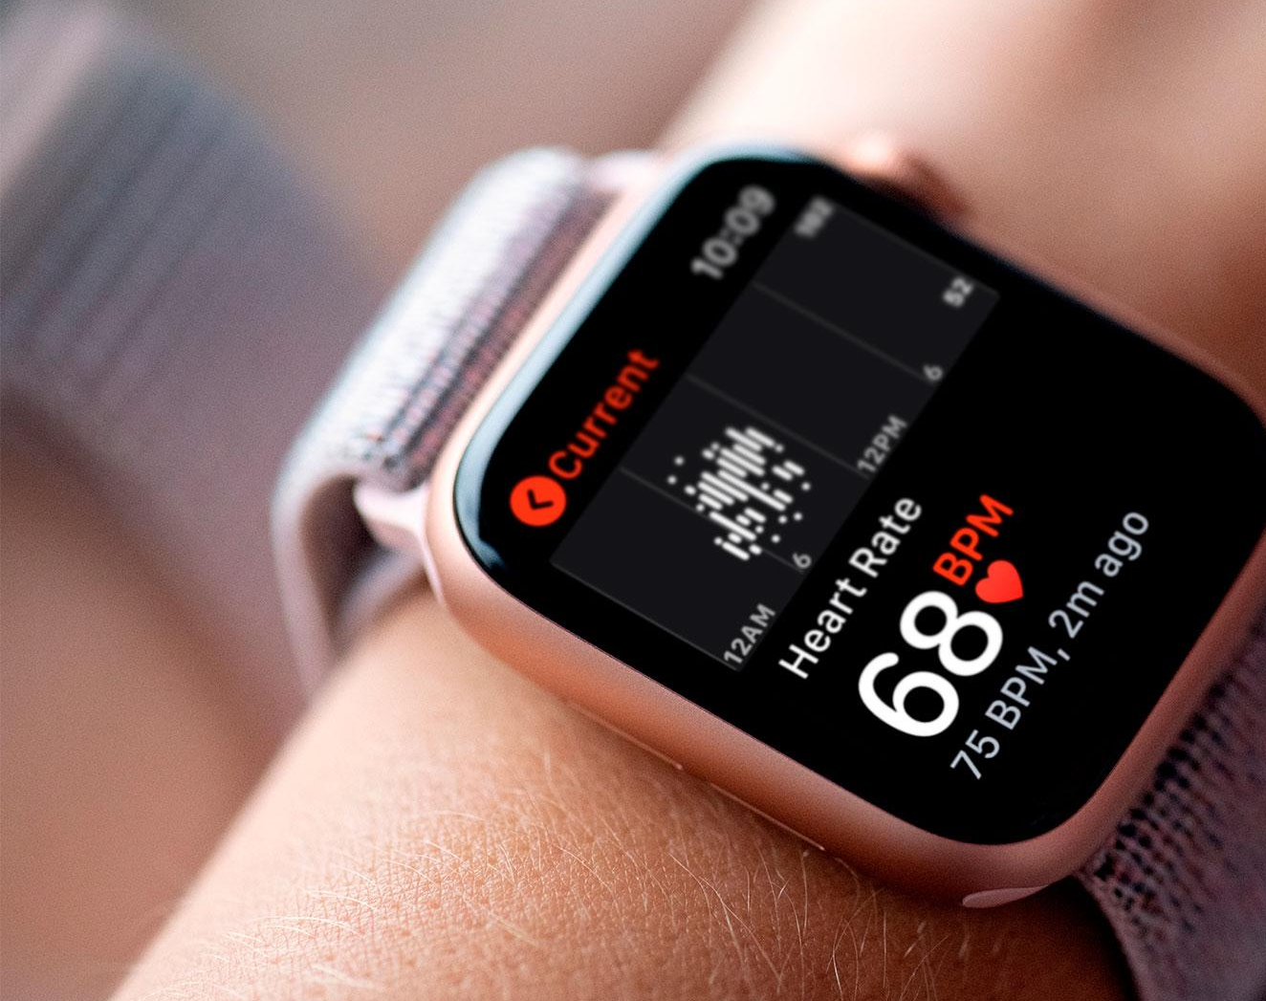
Exercises for Data Analysis of Heart Rate
Shuangling Yang

Slide 2
Exercise 1
Understanding the Dataset
This dataset consists of two groups of participants (groups 1 and 2). For each participant in both groups, there are three types of mat files, PPG data, True BMP, and Labels. PPG data contains two-channel PPG signals(PPG1,PPG2), three-axis acceleration signals(a_x,a_y,a_z), and one-channel ECG signals(ECG). True BMP indicates the true heart rate calculated from ECG signal from PPG data. And the Labels tell if the difference between the estimation and the ground truth is large than 5(1:less than 5, 0: large than 5).
There is not sufficient data for sport type 01 in both groups, so I decide to only investigate the influence of different types of sports(e.g. running and forearm and uparm movements) instead of the intensity of the sport on the heart rate. Since I don't take into account health conditions for this analysis, the data from the 8th person in group 2 with abnormal heart rhythm and blood pressure are excluded.
Because there is no ECG feature in PPG data for group 2 and ECG can be represented by BPM0, I exclude ECG data from my analysis.
Feature Engineering
I apply a bandpass filter between 0.4 and 4 Hz on two PPG signals and then standardize the dataset. Considering that all signals were sampled at 125 Hz and the BMP value was recorded in every 8-second time window with 6-second overlapping. I create an 8-second sequence window for PPG data so that there are 125*8=1000 rows in each sequence. Some statistical values, such as mean and skewness, can be extracted from the sequence.
I pack all the functions to load, combine and merge all data to create one integrated dataset.

Slide 3
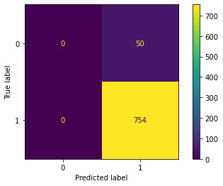
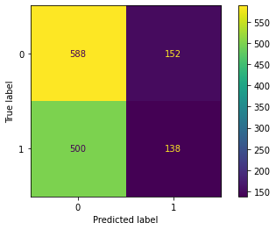
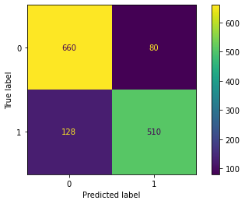
Exercise 1
Applying Machine Learning Models
I apply the SVC model and check the accuracy of prediction with a confusion matrix. It can be seen below that the accuracy is surprisingly high (0.9378), which means that there could be some hidden factors that need to be noticed. Then I find out the dataset is very imbalanced. This could be the reason for the high accuracy.
It is found that only 6% of the data is labeled as 0, meaning the data is very imbalanced. The dataset is therefore resampled using function SMOTEENN() to balance the data, after which SVC is applied again. It turns out that the accuracy drops to 0.52, indicating that the model is not a good one. Then I try to use other machine learning models to improve the result.
In this case, the classification method of Logistic Regression performs well with improved accuracy of 0.849. Of course, accuracy is not the only criteria to evaluate a model.
With regards to future work, more features could be investigated and calculated in the analysis. Also, some deep learning techniques such as LSTM may be used for this time-series data.

Slide 4
Exercise 2
Understanding the Dataset
This dataset contains 11 attributes, ID, Group, Age, BMI, Gender, Smoker, Day, Block, HR, ACC, QI. The data is collected from two groups, health control ('Control') and patients with a history of substance abuse ('Patient'), monitoring their average heart rate(HR) during the day and night. Apart from basic information such as Age and Gender, quality indicator (QI) is also recorded in the dataset.
From the information below showing the data structure and type, it is observed that most of the data is object, and HR, ACC, and QI are numerical data. When checking the missing values in the dataset, only the Smoker attribute has 45 null values, which are filled with 'Na'.

Slide 5
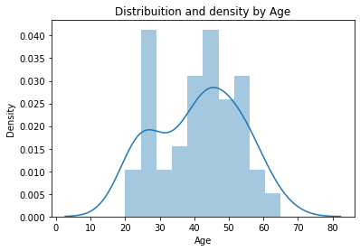
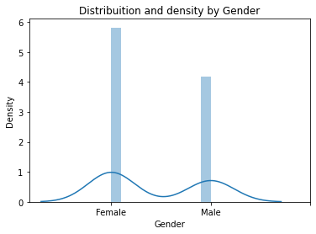
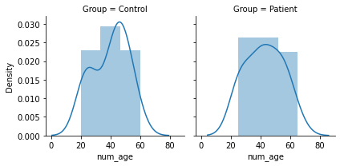
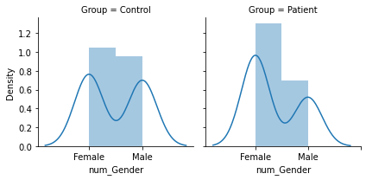
Exercise 2
Data Exploratory
The plots show the distribution and density by Age and Gender, which are also shown by different groups.
The original data of Age is replaced with numerical data using dic(). It is shown that the data are collected from people with ages ranging from 20 to 65+, and the distribution peaks at the twenties and forties. There is no obvious difference between the 'Control' and 'Patient' groups.
For the Gender attribute, I encode it with a value 0 for females and 1 for males. In the group of 'Patient', there is more female than male.

Slide 6
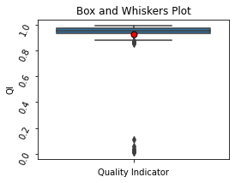
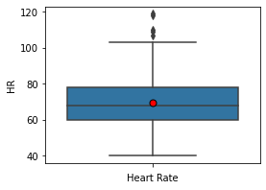
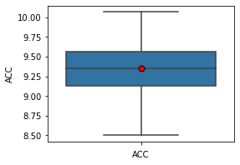
Exercise 2
Data Exploratory
There are extreme values (obvious outliers) in QI as shown in the plot, which are all coming from the same person with an 'ID' of 69. Since there is a limited amount of data, I replace those outliers with QI values randomly selected from the people in the same group with similar biological information, rather than excluding these data.

Slide 7
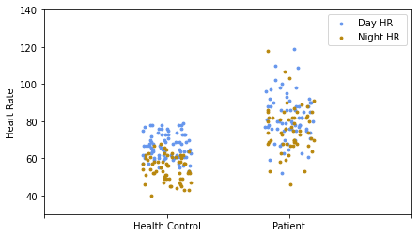
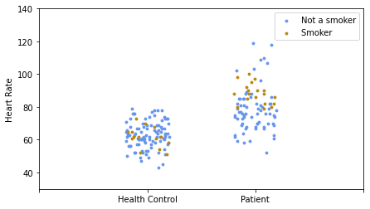
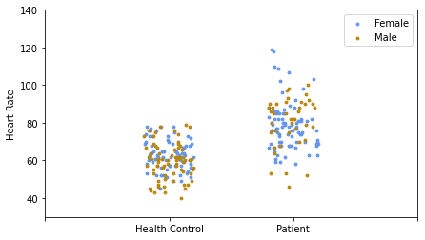
Exercise 2
Data Exploratory
I investigate the influence of Block, Smoker, Gender on HR in different groups by jitter plots. It should be noticed that the heart rate of group 'Patient' is larger and spreads more than the group 'Control', indicating that substance abuse could lead to a higher heart rate with a larger spread.
The heart rate during the day is large than that during the night, which could be related to more activities during the day.
There is no clear impact of Smoker and Gender on HR.

Slide 8
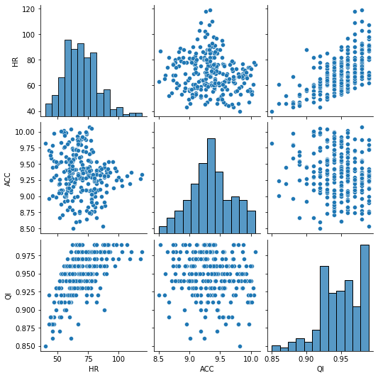
Exercise 2
Data Exploratory
No significant correlation between heart rate and ACC is observed, while there is a positive correlation between heart rate and quality indicator.

Slide 9
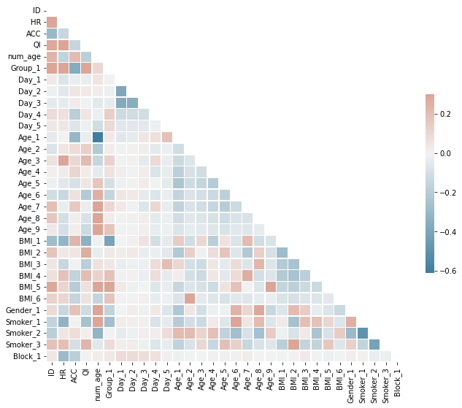
Exercise 2
Baseline
The attributes Group, Age, BMI, Gender, Smoker, Block are applied with one hot encoding in order to convert object to numerical value. The correlation plot is based on the one hot data. The attribute Day is excluded and not be considered in the model training since it has the least correlation with heart rate according to the correlation.

Slide 10
Exercise 2
Baseline
Linear regression is applied to the model as a baseline. The used evaluation method mean squared error is 0.23, which is small

